Slide 1


Washington DC Airbnb analysis
Lok Tin Kevin Chan

Slide 2
Objective
What do end users (customers) care about during their Airbnb stay?
What factors affect listing price of an Airbnb listing

Slide 3

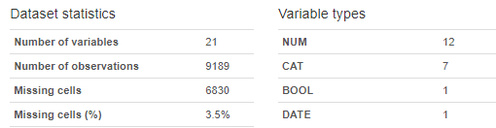

Data – Inside Airbnb: Washington DC
Reviews Dataset
Data containing reviews of Airbnb listing
Objective # 1
Listing Dataset
Data related to listing (price, neighbourhood, location..ect)
Objective #2

Slide 4
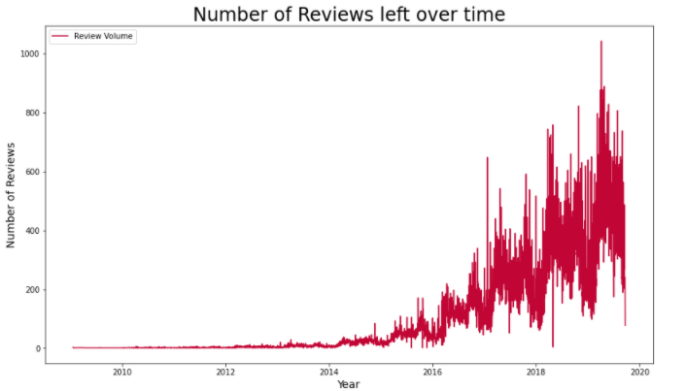
Objective 1: Analysis – Number of reviews
To understand what user care about during their Airbnb stays, we look at the reviews left.

Slide 5
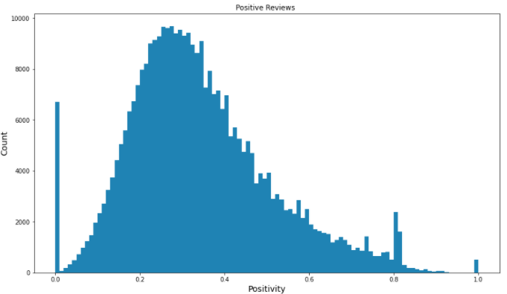
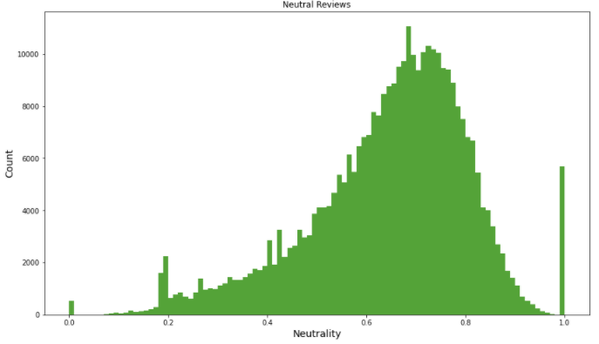
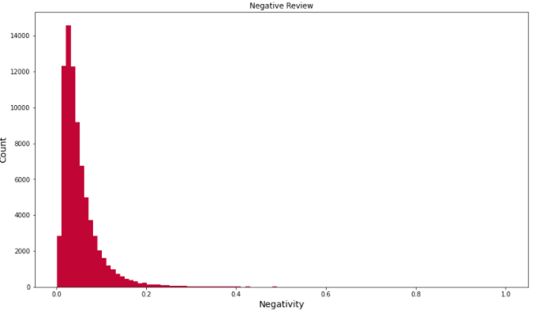
Objective 1: Analysis – Sentiment Analysis
Using VADER (Valence Aware Dictionary sEntiment Reasoner) we analysis the reviews.
From the above, we can observe that majority of the reviews are perceived as neutral reviews with slight positivity, and not a lot of negative reviews. Thus there is not much really learnt from looking at the just the sentiments

Slide 6
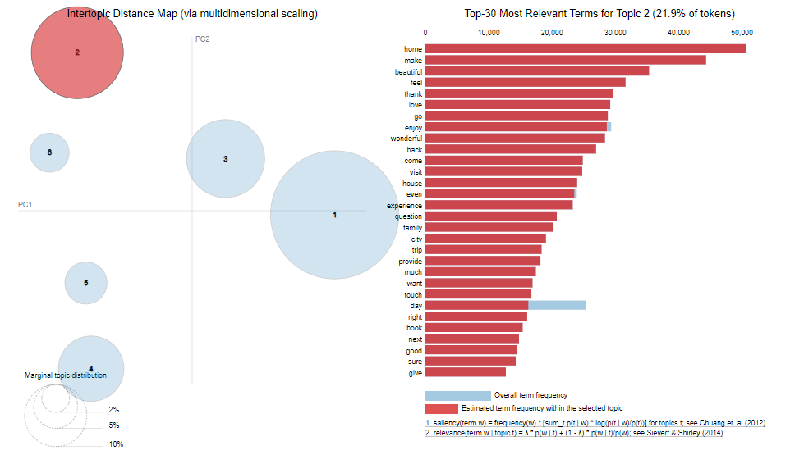
Objective 1: Analysis – LDA
Though to understand what customer care, using conduct topic modelling with LDA to understand the cluster common word groups/similar expression together.

Slide 7
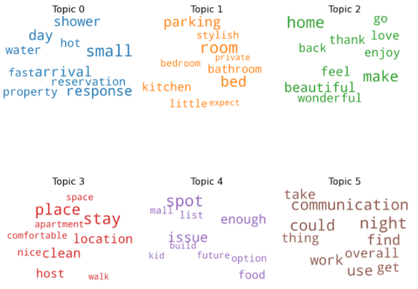
Objective 1: Analysis – LDA
Topic 1: Airbnb Location
Topic 2: Experience
Topic 3: Arrival / getting to Airbnb
Topic 4: Apartment
Topic 5: Nearby locations
Topic 6: Host interaction

Slide 8
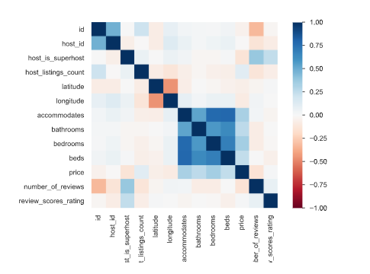
Objective 2: Analysis – Price Correlations
Price is positively correlated to accommodates, bathrooms, beds, bedrooms (which are related to size), number of listing per host (though maybe skewed by Zeus)
more interestingly Price is negatively correlated to is whether host is superhost. Which may indicate that superhost are more realistic at pricing their listing.

Slide 9
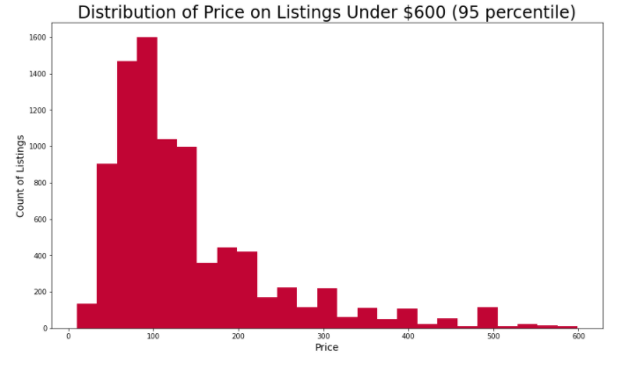
Objective 2: Analysis - Price
The six groups can be

Slide 10
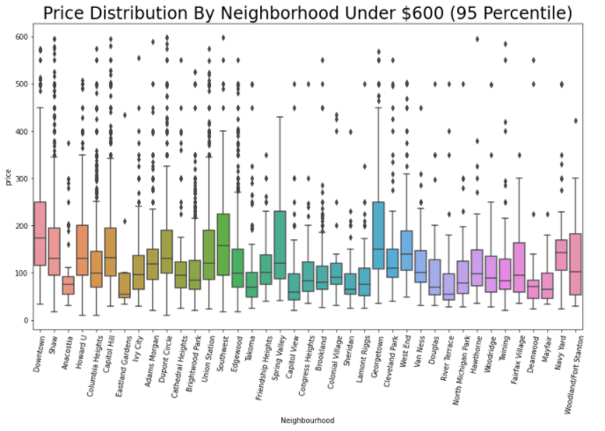
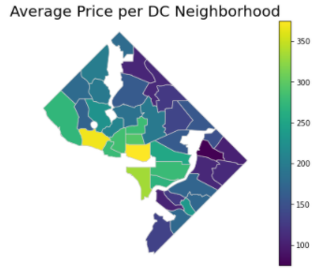
Objective 2: Analysis - Location
From the boxplot and the map, we can observe that most expensive neighborhood on average for AirBnB is Georgetown and Southwest neighborhood followed by capital hill area, while the least expensive neighborhood on average is Mayfair.

Slide 11
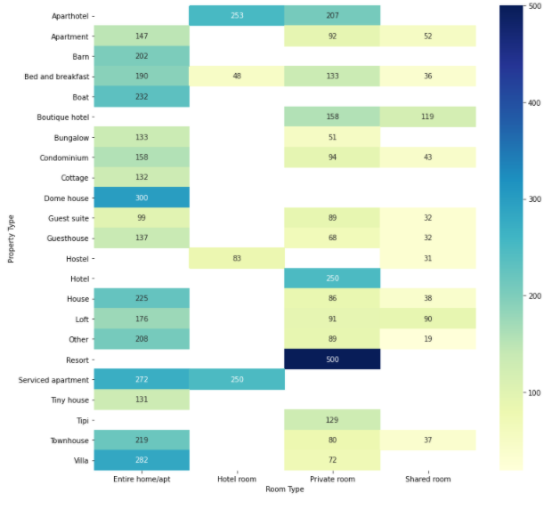
Objective 2: Analysis – Heatmap
This chart gives us a much better understanding of the price breakdown in DC based on property type and room type.
It can be observed that private room in resort type is the most expensive. For property type that Entire home/aprt for those that have the option is the most expensive as expected.

Slide 12
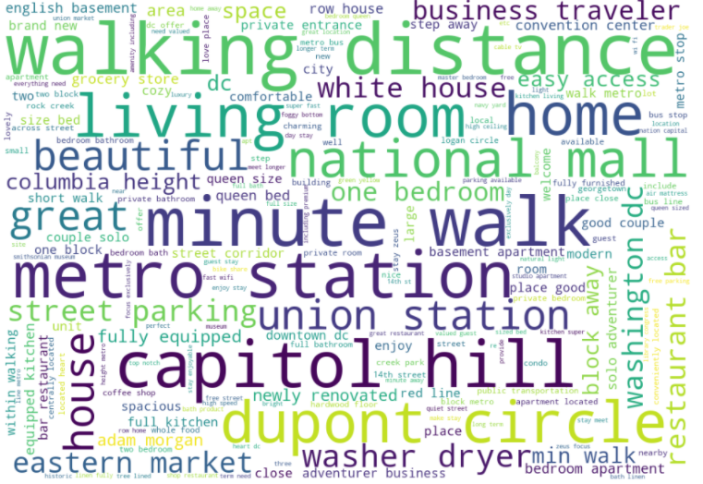
Objective 2: Analysis – Wordcloud from listing description
From the above word cloud, we can see that in summary section, most host owners that has a higher price list mentions most about it's location relative to sightseeing spots (e.g. National Mall, Capital Hill), transport (metro station) then followed by amenities it provides. This thus further emphasis that location, location and location matters strongly when determining the price per night for AirBnB listings in Washington DC.

Slide 13
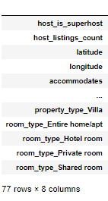
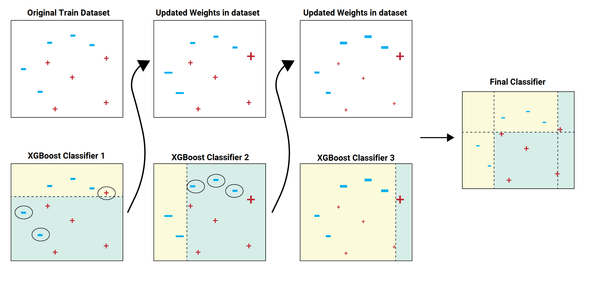
Objective 1: Simple Modeling - XGBoost
Model accuracy: 48.17%

Slide 14



Conclusion
What do end users (customers) care about during their Airbnb stay?
What factors affect listing price of an Airbnb listing
From the EDA, we can observe various factor affect the listing price per night, but the most important factors are location and size of the listing.
From the Topic modelling, we find that user talks a lot about Airbnb location, and the experience during the stay. This is further reinforced with the description of the listing with location of the Airbnb / nearby sightseeing locations as the most common words used.

